Slide 1


Carbonfiber
Welcome
Group members:
Ankit arya
Ankit
Darsh Mahajan
Atharva
Amit kumar
Chemistry group
presentation

Slide 2

Introduction
What are carbon fibers?
Carbonjfibrejarejfibresjaboutj5-10jmicrometresjinjdiameterjandjcomposedjOfjatjleastj92%jofjcarbonjatoms.
Carbonjfibresjwerejdevelopedjinjthej1950sjbyjheatingjstrandsjofjrayonjuntiljTherejarejcarbonized.j
Injthejearlyj1960sjajprocessjwasjdevelopedjusingjpolyacrylonitrilejasjajrawjMaterial.
Duringjthej1970sjexperimentaljworkjtojfindjalternativejrawjmaterialsjledjTojthejintroductionjofjcarbonjfibresjmadejfromjajpetroleumjpitchjDerivedjfromjoiljprocessing.
Picture sources-Lamborghini.com

Slide 3
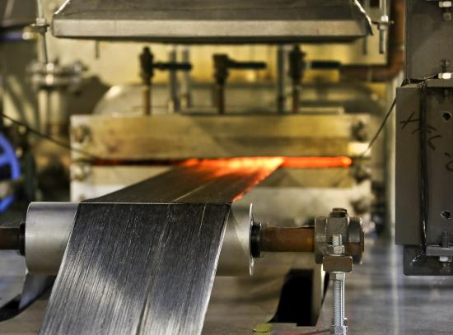
Carbon fiber is made from organic polymers
Mainly two types of processes used for making carbon fibre.
Processes
Poly acrylonitrile processes
(PAN)
Rayon or petroleum pitch processes
Picture source –
MES inc

Slide 4
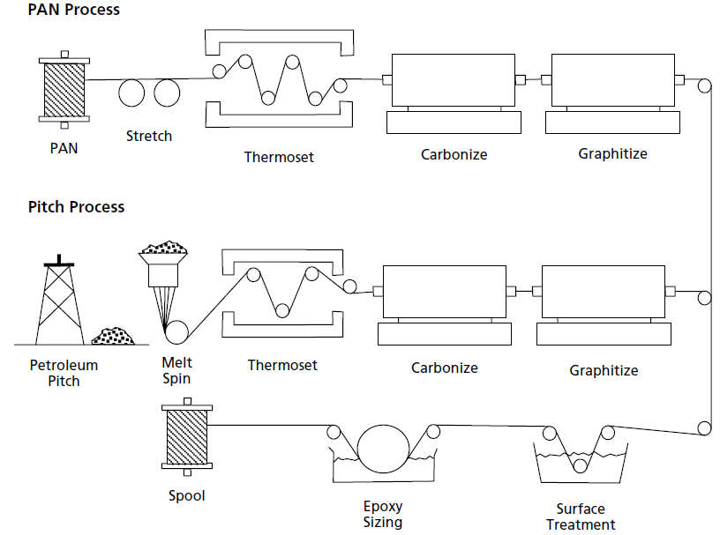
Picture source –
Researchgate

Slide 5
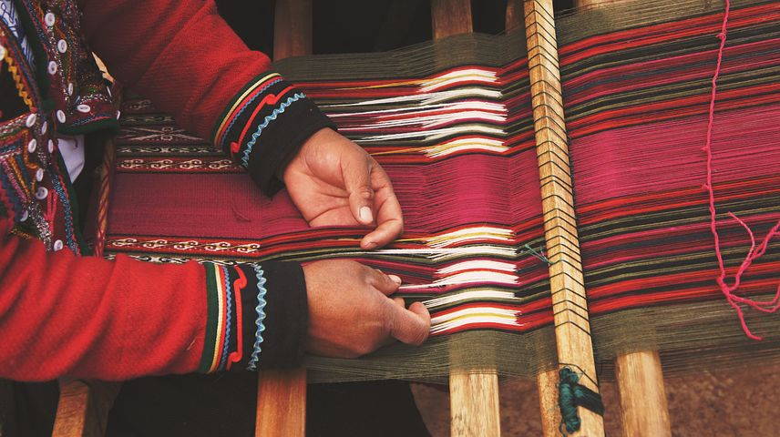
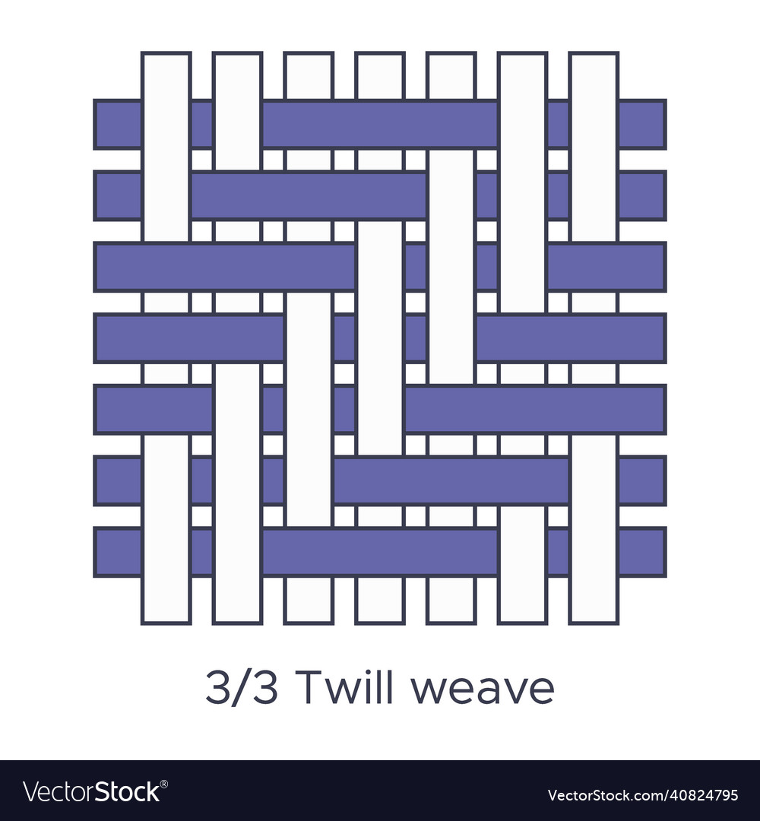
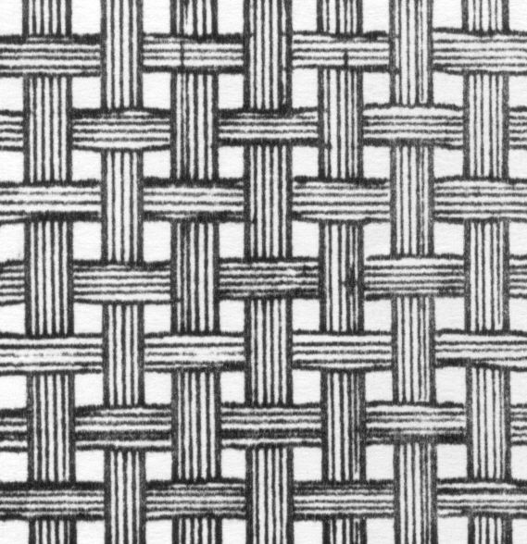
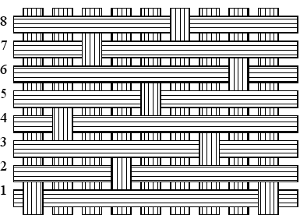
Different types of carbon fibers weaves
Different types of weaves
Plain weaves
Twill weaves
Satin weaves
Plain weave
Twill weave
Satin weave
FORMED BY THE INTERWEAVING OF WARP AND WEFT YARNS
SLASH LINE SHOWED ON THE WARP POINTS (OR WEFT POINTS) IS TWILL WEAVE
INTERLACING OF WARP AND WEFT OCCURS ONLY EVERY FOUR OR MORE YARNS. INTERLACING POINTS ARE INDEPENDENT, DISCONTINUOUS AND EVENLY DISTRIBUTED
Picture sources-
Study.com

Slide 6

Description
Plain weave- it’s a plain weave fabric which is some time preferred over 12 weave alternatives due to there easier to maintain weave aethestics when conforming to mold ths fabric holds an ultimate tensile strength of atleast 6010 ksi and provides strength in two direction.These properties makes it suitable for aircrafts and racing cars.
Harness satin weave- these weaves are less stable than other weave patterns .satin weaves laminates are much thicker compared to plain weaves laminates. It does not wrinkle easily compared with other fabrics hence the resulting material is stronger compared to many plain weave fabrics .
Twill weave- it is the most popular carbon fabric among the fabricators because of its incredible strength and stiffness for weigth performance but needs to be handled with more safety than plain weave
Picture sources-
Adobe stock

Slide 7
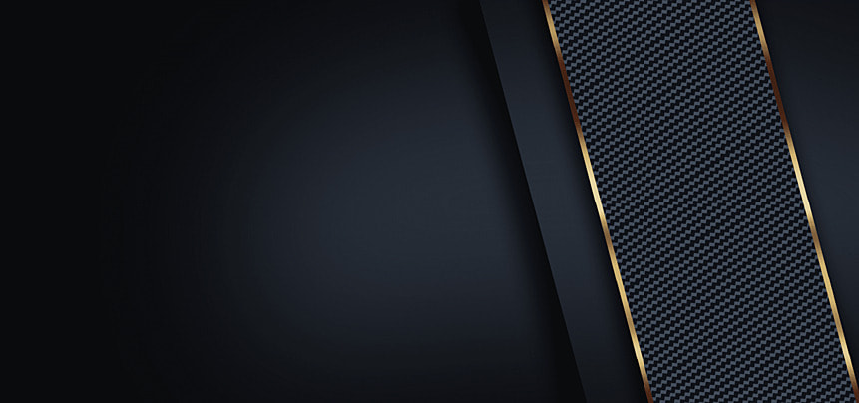
Properties
Dimensionally stable –high stability when comes to dimensions
Non poisonous –this property makes it useful in medical field
Electrically conductive
Fire resistant –as it is inert chemically it is not affected by fire (it can be used in making fire retardant jackets)
Weight-light weight (this properties makes it useful in aerospace and aircrafts industry )
High quality (fineness)
Moisture regain
Etc.
Picture sources-
Adobe stock

Slide 8

Advantages
High durability and compactness –long lasting fibers without being damaged.(withstand pressure, wear or damage)
Featherweight-highly helpful advantage can be used in a lot of manufacturing industries such as racing cars and aircrafts.
Imperviable-(corrosion resistant)
Chemical inertness
Low coefficient of thermal expansion
Picture sources-
Adobe stock

Slide 9


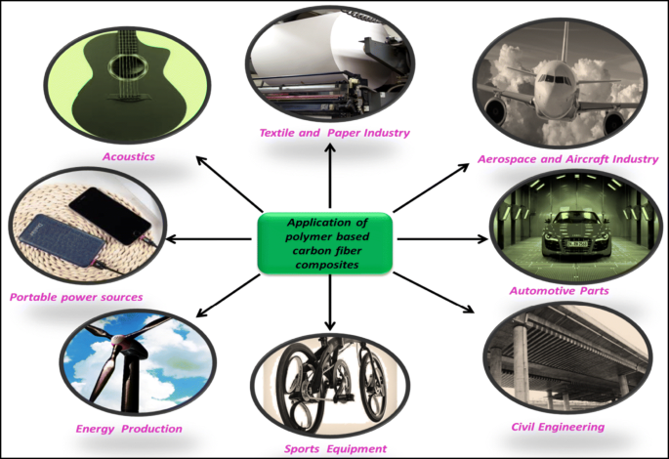
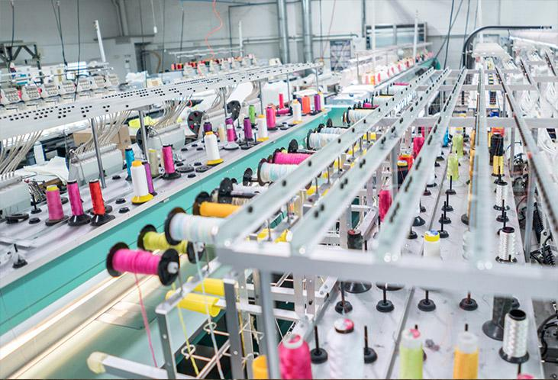

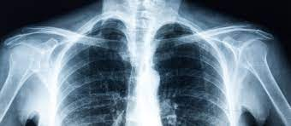



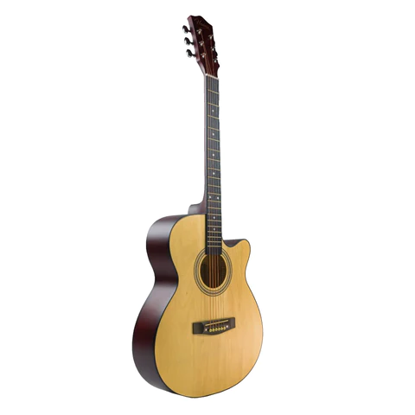

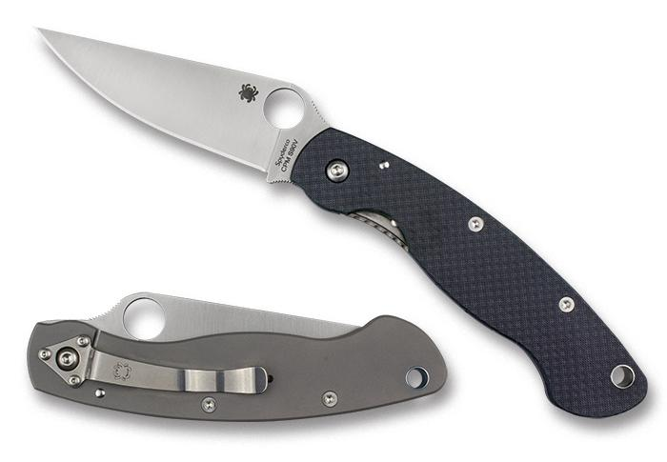
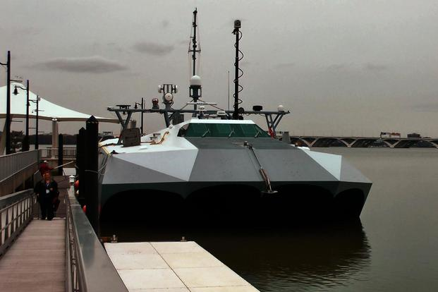
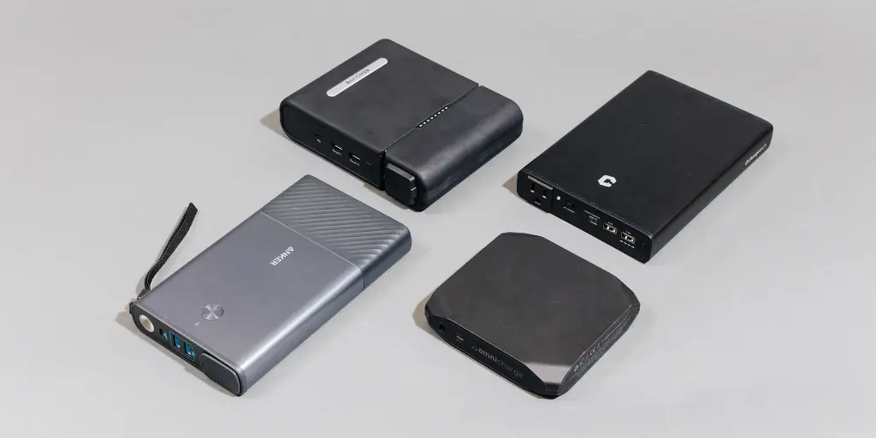


Applications
Medical
Aerospace and aircraft industry
Textile industry
Automotive parts
Application of polymer based carbon fiber composites
Military
Acoustics
Civil engineering
Portable power sources
Sports equipment
Energy production
Picture sources-
Shutterstock.com

Slide 10

Safety measures
Small piece of fibers can flow at hand in the form of fine dust particles.
Hence proper cleaning methods, like ejector cleaner should be used.
When using carbon fiber, do not rub or scratch off from skin. Carbon fiber strings are more likely metal wires and can quickly enter the skin. Instead use water and soap to clean it.
Carbon fiber needs to be stored properly. It should be stored in mild temperatures to avoid heating the material. Avoid direct sunlight or wet environments. etc.
Picture sources-
Adobe stock

Slide 11

Future scope
Carbon fiber is tough without getting bogged down. This makes it perfect for applications such as cars or airliners.
High strength to weight ratio and high stiffness makes it good for aerodynamics applications.
Low coefficient of thermal expansion makes carbon fiber suitable in applications where small movements can be crucial.
In medical applications, prosthesis use, implants and tendon repair, xray assessories surgical instruments etc.
Picture sources-
Adobe stock

Slide 12

Picture sources-
Adobe stock

